Slide 1
Mergers and Acquisitions
By:
Dr. Saurabh Chadha

Slide 2
Introduction
Mergers and acquisitions have long been a popular form of corporate investment that provides a healthy return to target stockholders.
However, their value to acquiring shareholders is less understood.
Many skeptics point out that given the hefty premiums paid to target stockholders, acquisitions tend to be negative-valued investments for acquiring stockholders.

Slide 3
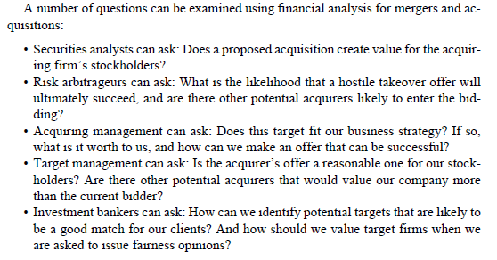
Introduction

Slide 4
Introduction
In this chapter we focus primarily on the use of financial statement data and analysis:
Directed at evaluating whether a merger creates value for the acquiring firm’s stockholders.
The topic of whether acquisitions create value for acquirers focuses on evaluating
Motivations for Acquisitions
Pricing of offers
Forms of payments
Likelihood that an offer will be successful
Example: Pfizer Inc’s acquisition of Wyeth in 2009 (cash and stock deal approx. $68 billion), Strategy: Creating the World's Premier Biopharmaceutical Company

Slide 5
Motivation for M&A
Taking Advantage of Economies of Scale or Synergy (Pfizer did not consider this the primary reason for Wyeth’s acquisition, management did forecast potential operational savings of $4 billion from combining the operations of the two firms)
Improving Target Management
Combining Complementary Resources (Pfizer viewed Wyeth’s strong presence in biotech drugs, vaccines and consumer health products as complementary to its own primarily prescription medicine focus, with the combination resulting in a broadly diversified health care company)

Slide 6
Motivation for M&A
Capturing Tax Benefits (Operating tax losses and loss carryforwards can be offset against the target’s taxable income / tax shield that comes from increasing leverage for the target firm)
Providing Low-Cost Financing to a Financially Constrained Target
Creating value through restructuring and break –ups.
Penetrating new geographies (Cross-border acquisitions)

Slide 7
Motivation for M&A
Increasing Product-Market Rents (By merging and becoming a dominant firm in the industry, two smaller firms can collude to restrict their output and raise prices, thereby increasing their profits)
This circumvents problems that arise in cartels of independent firms, where firms have incentives to cheat on the cartel and increase their output.
While product-market rents make sense for firms as a motive for merging, the two partners are unlikely to announce their intentions when they explain the merger to their investors, since most countries have antitrust laws which regulate mergers between two firms in the same industry.

Slide 8
Motivation for M&A
Increasing Product-Market Rents (By merging and becoming a dominant firm in the industry, two smaller firms can collude to restrict their output and raise prices, thereby increasing their profits)
Anti-competitive concerns were potentially significant for Pfizer’s acquisition of Wyeth, since at the time of announcement, Pfizer and Wyeth were the largest and twelfth largest pharmaceutical companies in the world.
Merger approval was required by the US federal Trade commission, European commission and regulatory bodies in China, Australia and Canada.
Cash rich companies goes for M&A to deploy their funds as they have pressure from shareholders to distribute surplus funds as dividends. Another excuse is diversification

Slide 9
Motivation for Pfizer’s Acquisition of Wyeth
Industry-wide and company-specific factors in 2009 that motivated Pfizer to acquire Wyeth.
Industry-wide factors:
Competition from generic drugs increasing and increased demand from lower-priced generics.
The traditional strategy of relying on a few blockbuster drugs became obsolete due to increased competition from generics.
Specialty manufacturers are successful in gaining approval for drugs that closely replicated the blockbuster drugs without infringing on its patent.

Slide 10
Motivation for Pfizer’s Acquisition of Wyeth
Industry-wide factors:
Tougher regulatory approval climate made in-house development of new ground breaking drugs more expensive, time-consuming and risky
Made Pfizer to acquire proven products rather to develop them in-house.
Increase in global demand-high growth opportunities in Latin America, Middle East and China.
The rapidly growing biotech segment represented an attractive diversification option for large pharmaceutical companies.

Slide 11
Motivation for Pfizer’s Acquisition of Wyeth
Company-specific factors:
The impending loss of patent protection for the blockbuster drug Lipitor (the world’s top selling drug, which accounted for 29% of Pfizer’s pharmaceutical revenues in 2008).
Combined with the Pfizer inability to create a successful follow-up drug threatened to create a huge revenue hole for the company in the next five years.
Also, torcetrapib, a promising potential replacement, had recently failed in late-stage testing.
This approaching issue, along with failed high quality pipeline, weakening company stock pressuring management to make a big move.

Slide 12
Motivation for Pfizer’s Acquisition of Wyeth
Historically, as well, Pfizer had grown by acquisition rather than by developing its own blockbuster drugs.
Major Acquisitions like Warner Lambert (2000 $89 billion) and Pharmacia (2003 $60 billion) keeping its product line full and giving it status as the world's largest pharmaceutical company.
Operationally through Wyeth’s acquisition, in the combined company no drug would represent more than 10% of total revenue cushioning sudden future loss of blockbuster like Lipitor.
Global presence in both developed and emerging markets.
Potential cost savings of $4 billion from increased economies of scale (layoffs (20,000 jobs) and deploying redundant operations.

Slide 13
ACQUISITION PRICING
The acquirer must be careful to avoid overpaying for the target.
Overpayment makes the transaction highly desirable and profitable for target stockholders.
But it diminishes the value of the deal to acquiring stockholders.
A financial analyst can use the following methods to assess whether the acquiring firm is overpaying for the target:

Slide 14
ACQUISITION PRICING
Analyzing Premium Offered to Target Stockholders
To assess whether the acquirer is overpaying for a target is to compare the premium offered to target stockholders to premiums offered in similar transactions.
If the acquirer offers a relatively high premium, the analyst is typically led to conclude that the transaction is less likely to create value for acquiring stockholders

Slide 15
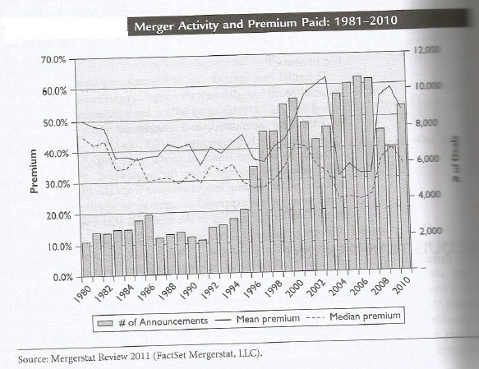
ACQUISITION PRICING

Slide 16
ACQUISITION PRICING
The above figure shows the mean and median premiums paid for U.S. targets between 1980 and 2010 relative to stock prices one week prior to the first acquisition announcement.
Mean and Median premiums have to be interpreted with caution since there is considerable variation across transactions, making it difficult to use these estimates as a benchmark.

Slide 17
ACQUISITION PRICING
Premiums can be misleading if an offer is anticipated by investors.
As a result, the stock price run-up for the target will then tend to make estimates of the premium appear relatively low.
This limitation can be partially offset by using target stock prices one month prior to the acquisition offer.
However, in some cases offers may have been anticipated for even longer than one month.

Slide 18
ACQUISITION PRICING
Finally, using target premiums to assess whether an acquirer overpaid ignores the value of the target to the acquirer after the acquisition.
i.e. Value of target after acquisition = Value as independent firm + Value of merger benefits
The value of the target before acquisition is the present value of the free cash flows for the target if it were to remain an independent entity

Slide 19
ACQUISITION PRICING
The benefits of the merger include such effects as improvements in target operating performance from economies of scale, improved management, or tax benefits, as well as any spillover benefits to the acquirer from the acquisition.
Clearly, acquirers will be willing to pay higher premiums for targets which are expected to generate higher merger benefits.
Thus, examining the premium alone cannot determine whether the acquisition creates value for acquiring stockholders.

Slide 20
ACQUISITION PRICING
Analyzing Value of the Target to the Acquirer
Whether the acquirer has overpaid for the target is to compare the offer price to the estimated value of the target to the acquirer.
The most popular methods of valuation used for mergers and acquisitions are earnings multiples and discounted cash flows.

Slide 21
ACQUISITION PRICING
Analyzing Value of the Target to the Acquirer
First compute the value of the target as an independent firm.
This provides a way of checking whether the valuation assumptions are reasonable, since for publicly listed targets we can compare our estimate with premerger market prices.
It also provides a useful benchmark for thinking about how the target’s performance, and hence its value, is likely to change once it is acquired.

Slide 22
ACQUISITION PRICING
Analyzing Value of the Target to the Acquirer
“Earnings Multiples Approach or P/E Multiple Approach”
Step One: Forecasting Earnings
Earnings forecasts are usually made by first forecasting next year’s net income for the target, assuming no acquisition.
In other words, build a pro forma income model for the next year for the target before acquisition.
Then, build a pro forma income model for the next year for the target after acquisition.
Forecasted Net Income before and after Acquisition.

Slide 23
ACQUISITION PRICING
Analyzing Value of the Target to the Acquirer
“Earnings Multiples Approach or P/E Multiple Approach”
Step Two: Determining Price-Earnings Multiple
Summary of Price-Earnings Valuation for Targets
Value of target as an independent firm | Target earnings forecast for the next year, assuming no change in ownership, multiplied by its premerger PE multiple. Make sure for pre-merger PE multiple, the price is before the date of announcement.
Value of target to potential acquirer | Target revised earnings forecast for the next year, incorporating the effect of any operational changes made by the acquirer, multiplied by its post-merger PE multiple.

Slide 24
ACQUISITION PRICING
Analyzing Value of the Target to the Acquirer
“Earnings Multiples Approach or P/E Multiple Approach”
Limitation of PE Valuation
PE multiples assume that merger performance improvements come either from an immediate increase in earnings or from an increase in earnings growth.
Thereby, ignoring the fact that the improvements and savings can come in many forms.
—Gradual increases in earnings from implementing new operating policies, elimination of overinvestment, better management of working capital etc.
PE models do not easily incorporate any spillover benefits from an acquisition for the acquirer.

Slide 25
ACQUISITION PRICING
Analyzing Value of the Target to the Acquirer
“Discounted Cash Flows (DCF) Approach”
Step One: Forecasting Free Cash Flows
Earnings forecasts are usually made by first forecasting FCF for the target, assuming no acquisition.
In other words, build a pro forma model of expected future income and cash flows for the target before acquisition.
Then, build a pro forma model of expected future income and cash flows for the target after acquisition.
Forecasted FCF before and after Acquisition.
A typical forecast period is from 5 to 10 years.

Slide 26
ACQUISITION PRICING
Analyzing Value of the Target to the Acquirer
“Discounted Cash Flows (DCF) Approach”
Step Two: Compute the Discount Rate
Summary of DCF Valuation for Targets
Value of target as an independent firm | (a) Present value of Target FCFE assuming no acquisition, discounted at pre-merger Ke; or (b) Present value of Target FCFF assuming no acquisition, discounted at pre-merger WACC, less value of debt;
Value of target to potential acquirer | (a) Present value of Target FCFE including benefits from merger, discounted at post-merger Ke; or (b) Present value of Target FCFF including benefits from merger, discounted at post-merger WACC, less value of debt;

Slide 27
ACQUISITION PRICING
Pfizer’s Pricing of Wyeth (2009)
Deal Price: $68 billion
Premium Analysis: 29 percent premium to Wyeth’s stockholders over the market price on Jan 22, 2009 one day before the announcement of possible deal in Wall Street Journal.
This was below the mean (58%) and median (40%) reported for all acquisitions during that year in the US.
May be due to timing as this was the first major deal announcement since the beginning of the global financial crisis.

Slide 28
ACQUISITION PRICING
Pfizer’s Pricing of Wyeth (2009)
P/E Multiple Approach:
Pfizer’s pricing of Wyeth appears to be reasonable.
At the time of announcement, the P/E multiple for others firms in the pharmaceutical and bio-tech industries that were comparable to Wyeth ranged from 13.7 to 18.6.
Pfizer’s offer valued Wyeth at 15.4 times current earnings.

Slide 29
Thank You

